Slide 1
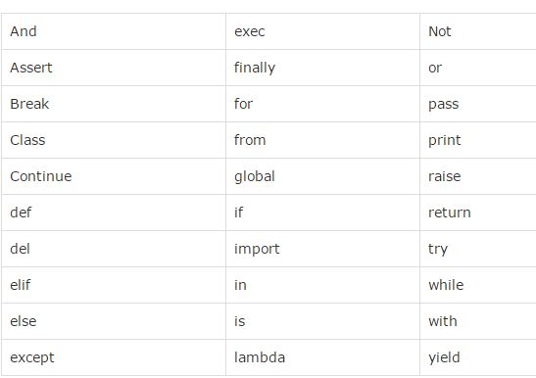
Introduction

Slide 2
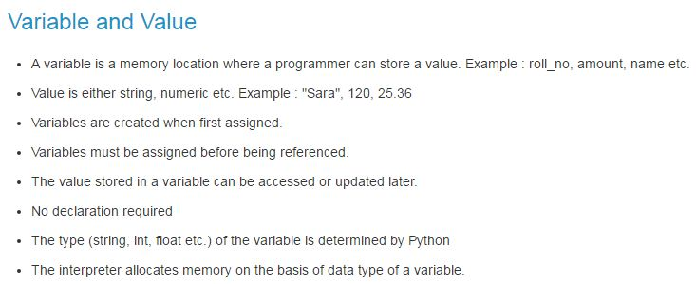

Slide 3
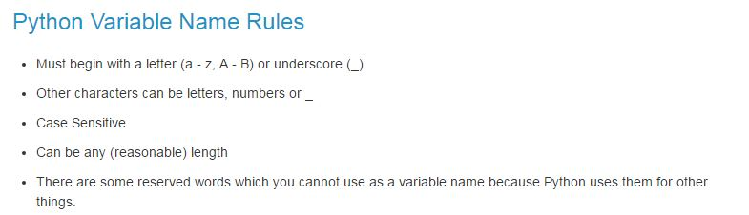

Slide 4
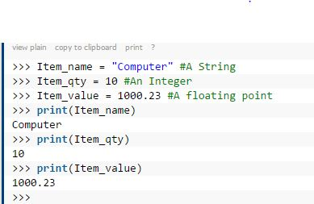

Slide 5
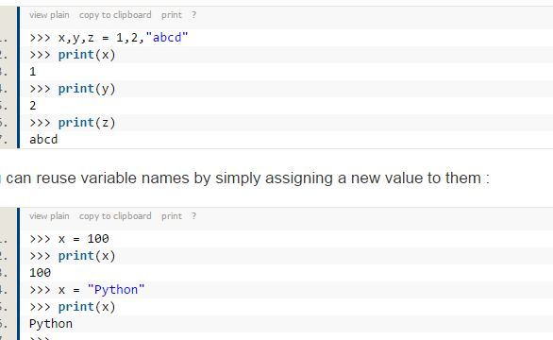

Slide 6
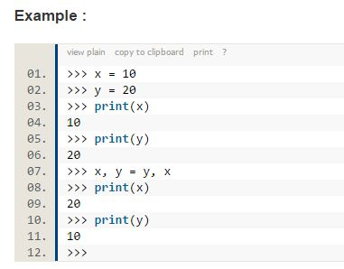

Slide 7
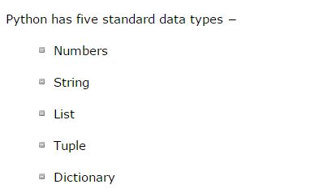

Slide 8
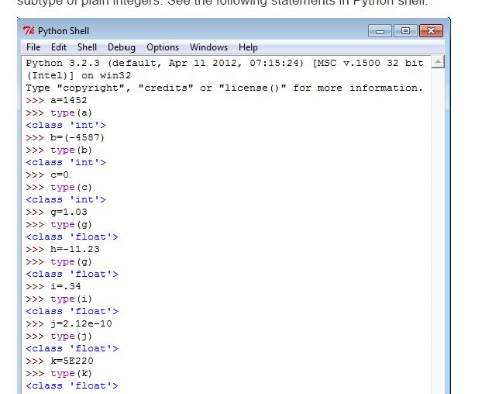

Slide 9
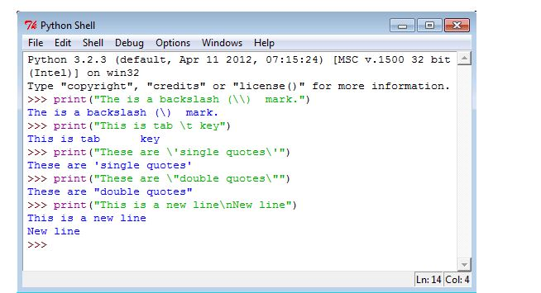

Slide 10
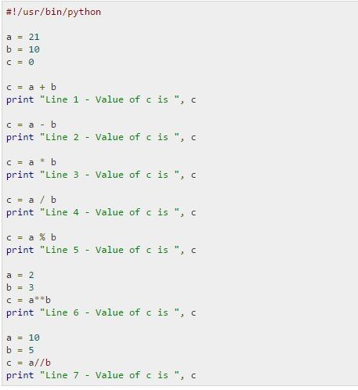

Slide 11
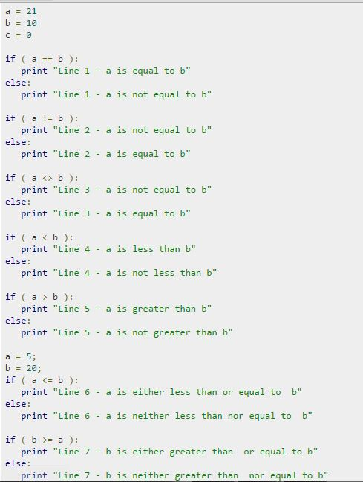

Slide 12
Multi line statement
a = 1 + 2 + 3 + \
4 + 5 + 6 + \
7 + 8 + 9
Or
a = (1+2+3+
4+5+6+
7+8+9)

Slide 13
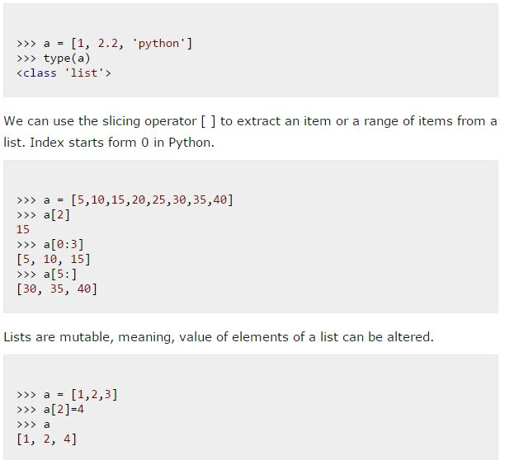
List in python

Slide 14
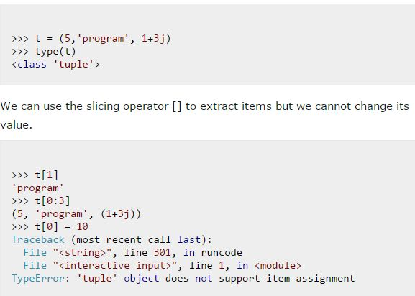
Tuples

Slide 15
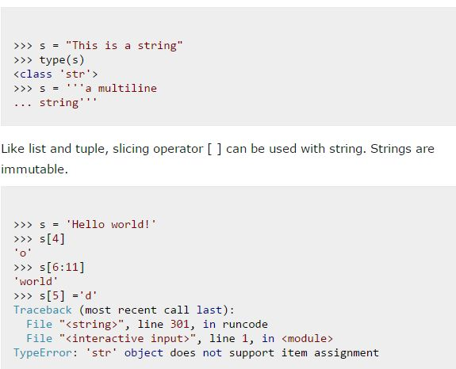
Strings

Slide 16
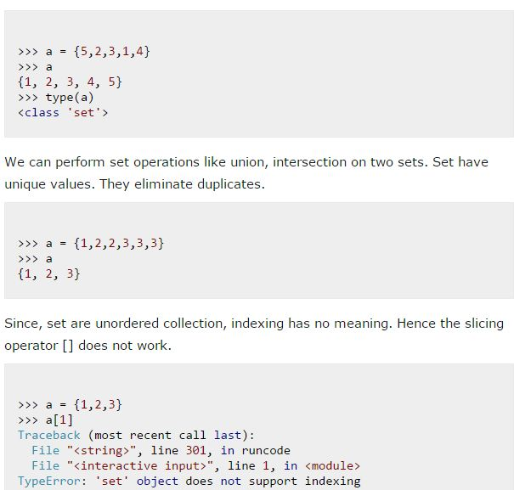
Python Set

Slide 17
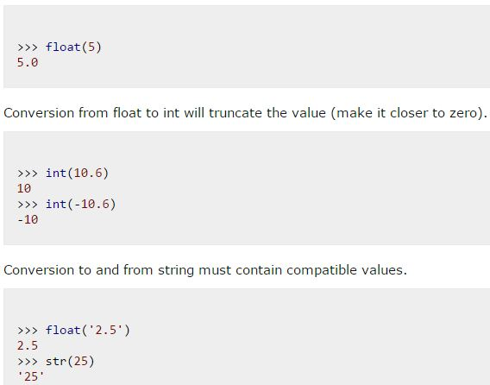
Conversion between datatype

Slide 18
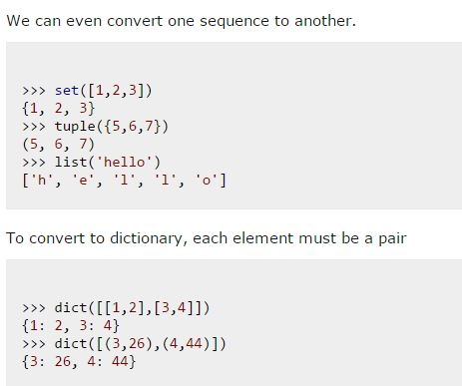

Slide 19
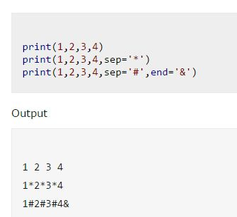
output

Slide 20
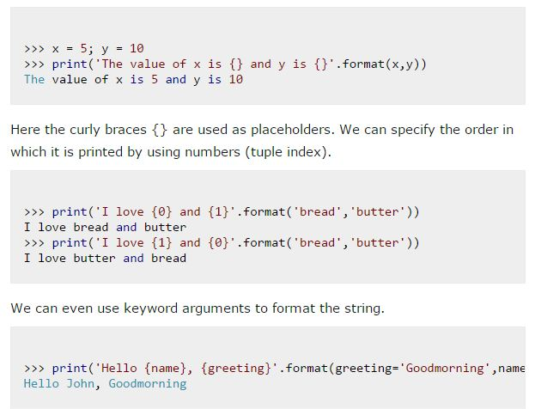

Slide 21
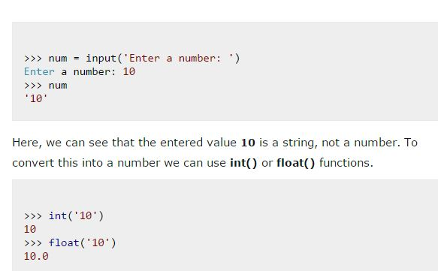
Input

Slide 22
# This program adds two numbers provided by the user # Store input numbers
num1 = input('Enter first number: ')
num2 = input('Enter second number: ')
# Add two numbers
sum = float(num1) + float(num2)
# Display the sum
print('The sum of {0} and {1} is {2}'.format(num1, num2, sum)

